Slide 1
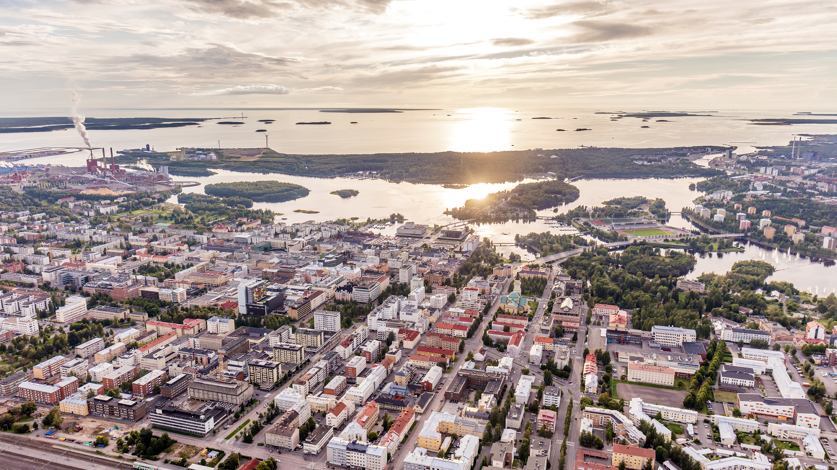

Slide 2
Notes:
Oulu has a long history in cooperation. Here, you can easily go from one place to another and everyone knows each other.
If you have a problem, an idea, or a solution, you can easily call anyone and ask for help.
You can also find the help you need from the networks of Oulu Innovation Alliance.
OIA is a community formed by eight partners, and a mode of interorganizational cooperation
OIA is formed by the City of Oulu, University of Oulu, Oulu University of Applied Sciences (Oamk), the Oulu Region Joint Authority for Education (OSEKK), Oulu University Hospital (OYS), VTT Tecnical Research Centre of Finland Ltd., Technopolis Plc., and Natural Resources Institute Finland (Luke)

Slide 3
Notes:
OIA is a cooperative community that unites science, research, and business that helps form business and jobs out of research and innovations.
You can find the very cutting edge know-how and networks in commercialization, health, industry, developing city attraction, ICT and digitalization
They aim to advance their sectors in Oulu as well as find and utilize synergy advantages.

Slide 4
Notes:
Oulu Innovation Alliance has focused its efforts into five distinct ecosystems, each functioning as a network of the best talent in their field.
They also have cross-sectional cooperation, thus making the most out of the synergy that is formed.
All in all, each ecosystem has their own part to play in making Oulu the fastest growing city region in Finland and top notch location for new business ventures and growth.

Slide 5
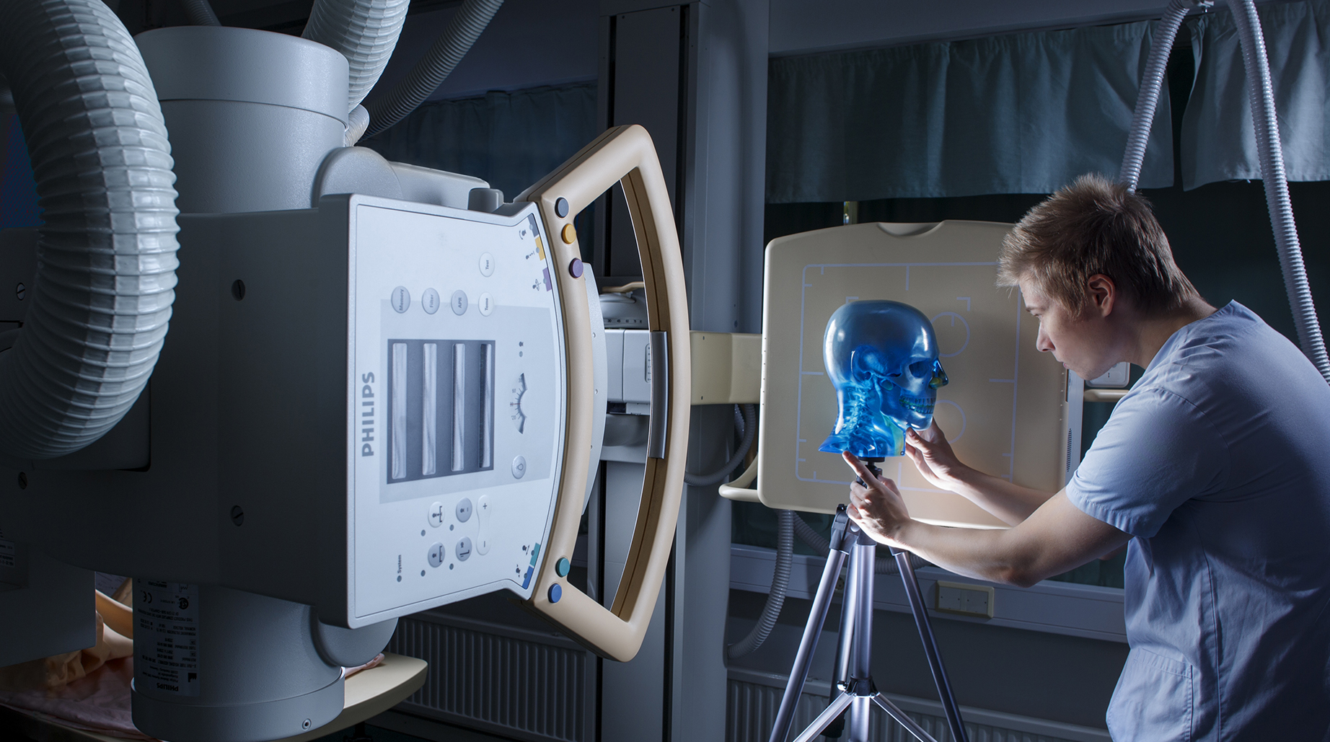
Notes:
OuluHealth ecosystem’s core function is to create synergy advantages for its actors through cooperation.
OuluHealth’s goal is to create solutions for the future of global healthcare.
OuluHealth Labs test environments enable the testing of products and services in authentic environments, and through OuluHealth Sparks equity finance instrument, companies can get convertible bond funding to cover piloting costs.

Slide 6
Notes:
OuluHealth’s vision is that by 2025
Oulu has effective and efficient customer-oriented social and healthcare services
Advancing individual-oriented health and wellbeing has been successful
Oulu has the world’s most intelligent university hospital

Slide 7
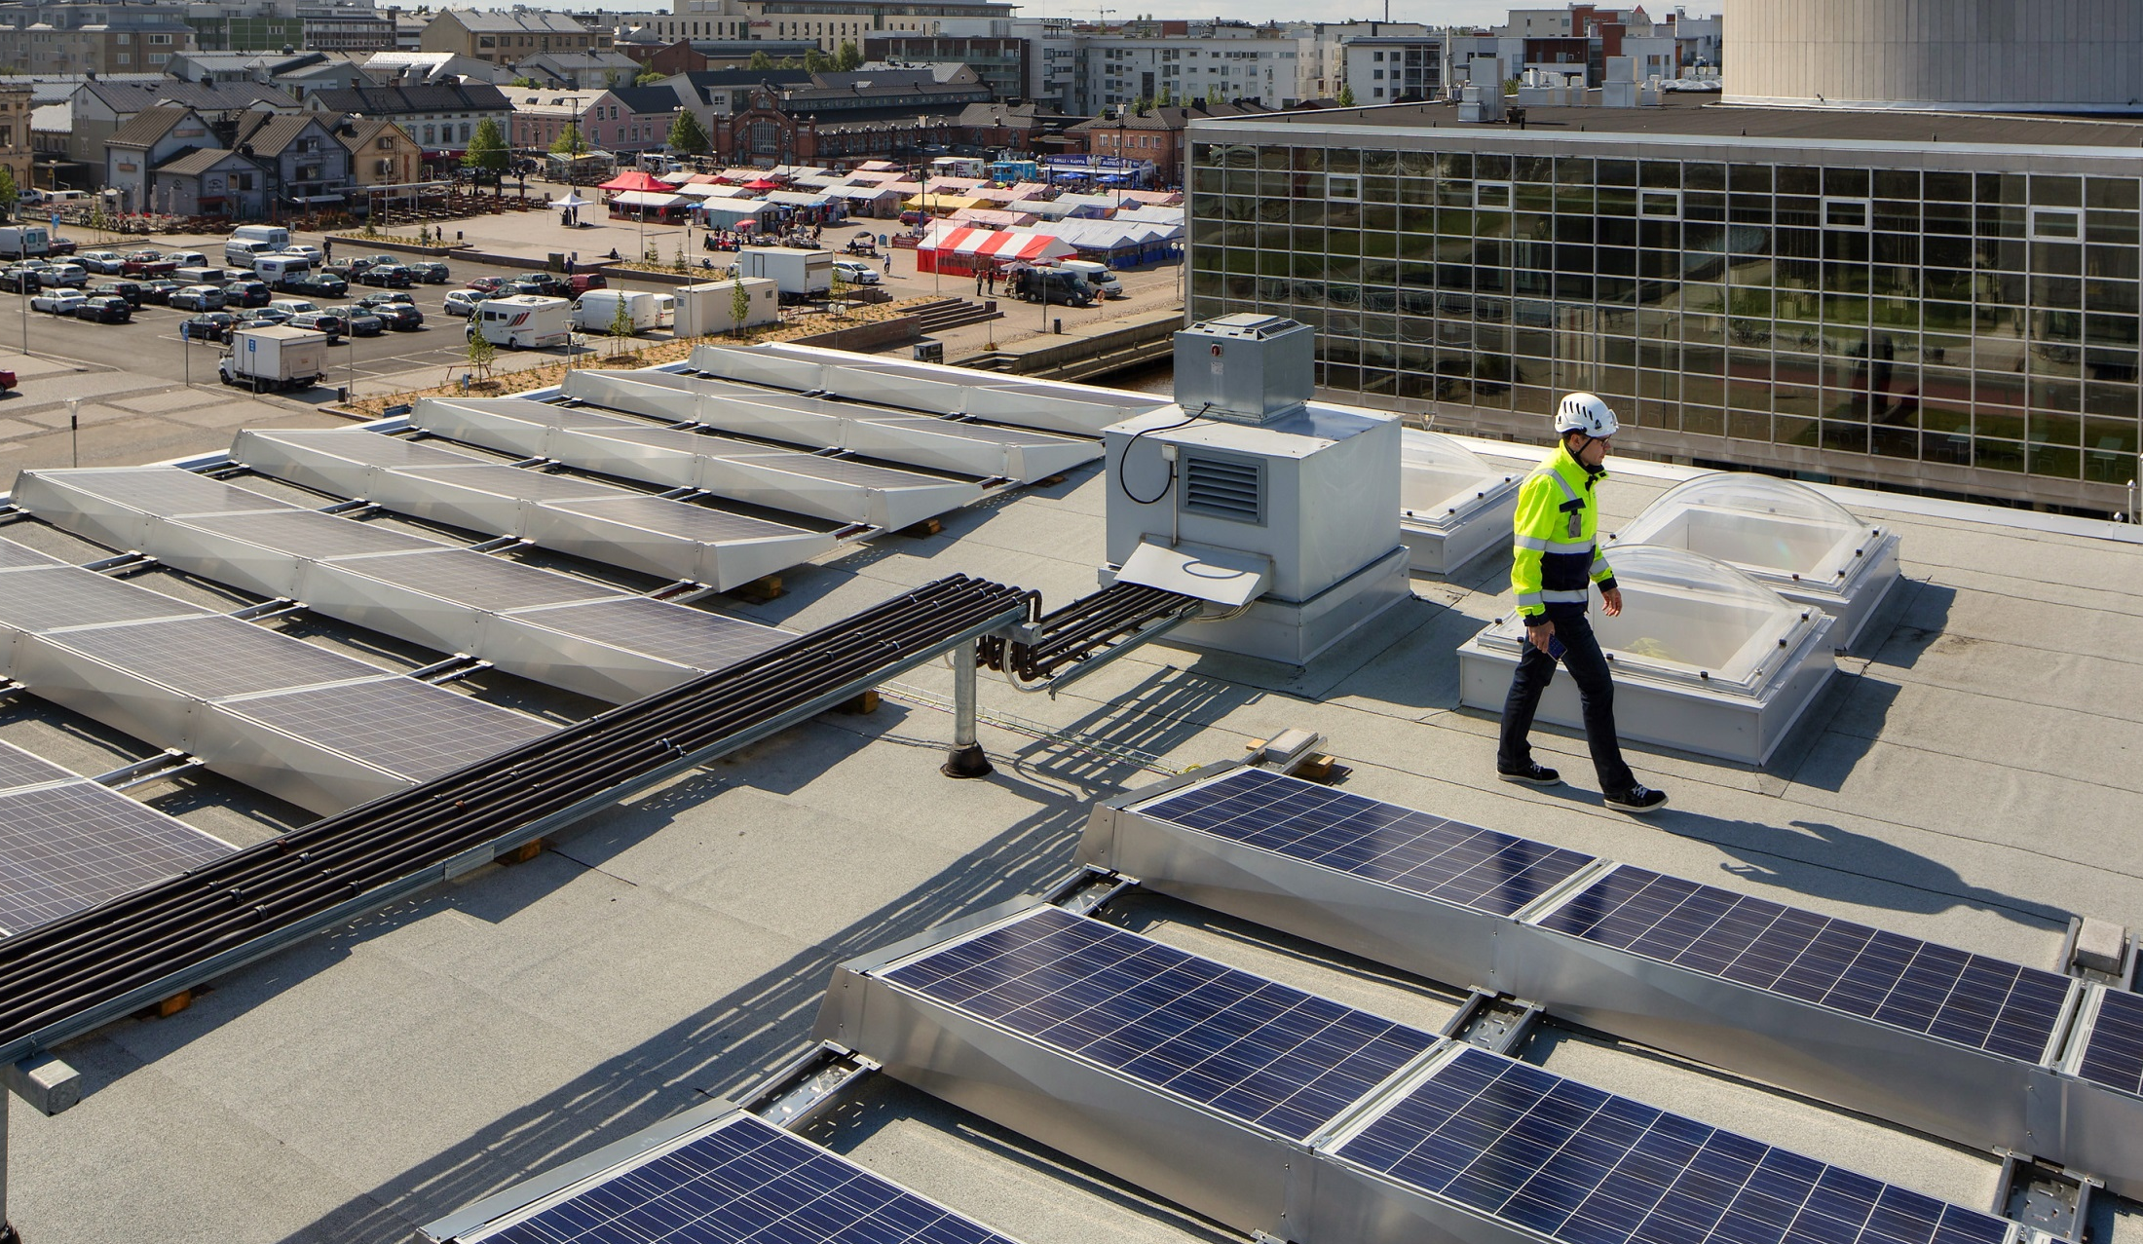
Notes:
Industry 2026 is an open innovation ecosystem, with the purpose of focusing the region’s cutting-edge research and know-how on the concrete needs of industry.
The ecosystem’s central mission is to be the go-to partner amongst its peers in metal and mechanical engineering industries’ eco-innovative solutions.
By the year 2020, the Industry 2026 ecosystem is a recognized R&D&I and company expert in the selected areas.

Slide 8
Notes:
Industry 2026 ecosystem’s vision is that by 2025 Oulu has:
High value-added bioeconomy products and services: The world’s most efficient wood raw material value chain
Robust steel and mechanical engineering industry value chain: The largest special-purpose steel excellency R&D&I center in the Nordics
Energy and environment resource effectiveness: Northern Ostrobothnia as a pioneer in ICT and Cleantech interfacing

Slide 9
Notes:
Northern City with Attractive Opportunities is one of OIA’s five ecosystems.
It produces and advances internationally attractive projects which will turn Oulu into Finland’s most intriguing city.
City Center Vision 2040 is a strategic plan, the goal of which is to form a future vision of a vital and distinctive Oulu city center.

Slide 10
Notes:
Northern City with Attractive Opportunities ecoystem’s vision is that by 2025:
Oulu has Finland’s most attractive R&D&I campuses, Linnanmaa and Kontinkangas
Oulu city center is the heart of the city
Oulu is the European Capital of Culture 2026

Slide 11
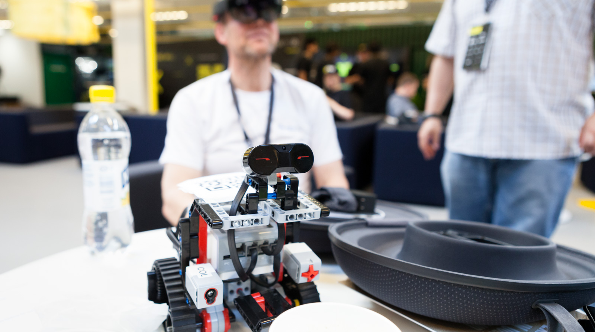
Notes:
ICT & Digitalization ecosystem has Oulu region’s largest private workforce – approx. 18,000 hi-tech jobs.
The ecosystem has chosen financial technology (Fintech) and the digitalization of social and welfare services as its focus themes.
The goals are e.g. to increase the visibility and credibility of the Fintech sector and raise Oulu to bo the forerunner in social and welfare service digitalization.

Slide 12
Notes:
ICT & Digitalization ecosystem’s vision is that by 2025:
Oulu is a 6G center and an intelligent community that utilizes digitalization
Oulu attracts and creates ICT specialists
Oulu is known globally for its IoT systems and data analytics excellence

Slide 13
Notes:
The Agile Commercialization ecosystem aims to increase commercialization of Oulu region’s innovations, support the growth of startups, increase appreciation for marketing and sales know-how, network companies and Oulu’s ecosystems internationally.

Slide 14
Notes:
Agile Commercialization ecosystem’s vision is that by 2025
Competence in Entrepreneurship and business is the focus of studies in Oulu and it has the most pro-entrepreneurship education in Northern Europe
Sales excellence is a spearhead in Oulu and has Finland’s best in sales know-how
We also have diverse startup development programs and Oulu is the best place for hi-tech startups in the North

Slide 15
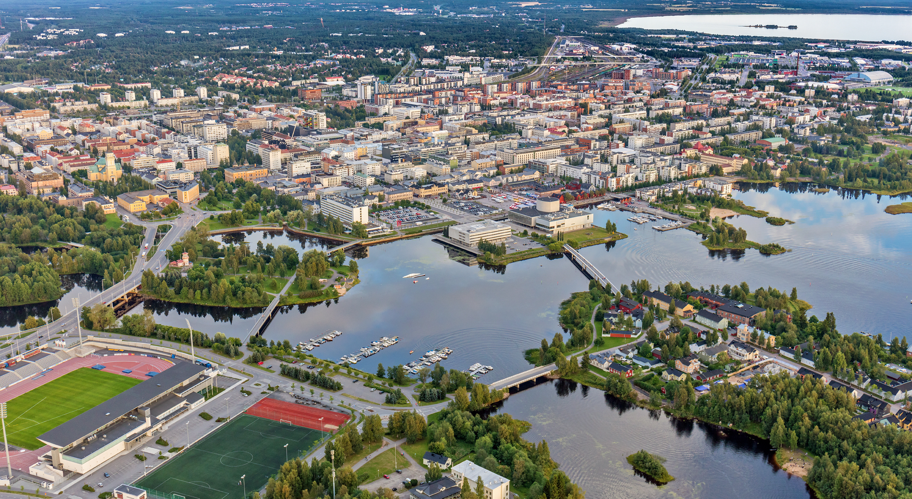
.
Notes:
Oulu is more than the sum of its parts.
OIA’s partners and ecosystems work together for the good of the region and are a gear in the innovation motor of Oulu.
Together we can achieve more than as individuals.
Everyone is welcome to co-create the future with us.

Slide 16
OuluHealth Salla Hirvonen salla.hirvonen@ businessoulu.com
ICT & Digitalization Heikki Ailisto heikki.ailisto@vtt.fi
Agile Commercialization Sami Niemelä sami.m.niemela@ oamk.fi
Northern City with Attractive Opportunities Olli Rantala olli.rantala@ouka.fi
Industry 2026 Pekka Tervonen pekka.tervonen@oulu.fi

